Slide 1

CSE- 321
Software Engineering
Lecture : 06 Software Processes
Fahad Ahmed
Lecturer, Dept. of CSE
E-mail: fahadahmed@uap-bd.edu

Slide 2
Lecture Outlines
Software Process Model

Slide 3
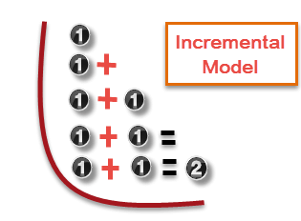
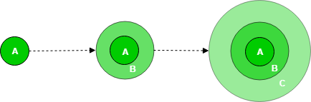
Incremental Model
Incremental process model is also know as Successive version model.
First, a simple working system implementing only a few basic features is built and then that is delivered to the customer. Then thereafter many successive iterations/ versions are implemented and delivered to the customer until the desired system is released.
Incremental Model is a process of software development where requirements are broken down into multiple standalone modules of software development cycle.

Slide 4
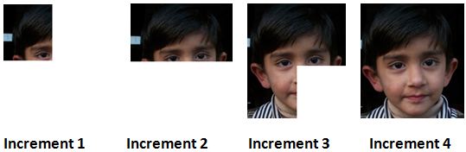
Example of the incremental model (Just for understanding)
In this daily life example, we want to draw a picture, first, we draw the first part of the picture as shown in increment 1, Similarly after completing the first part of the picture we have to add one another part of the picture labelled as increment 2 in the above picture. Similarly, we complete this picture in four increments.
https://t4tutorials.com/incremental-model-in-software-engineering-advantages-disadvantages-examples-case-study-of-incremental-model/

Slide 5
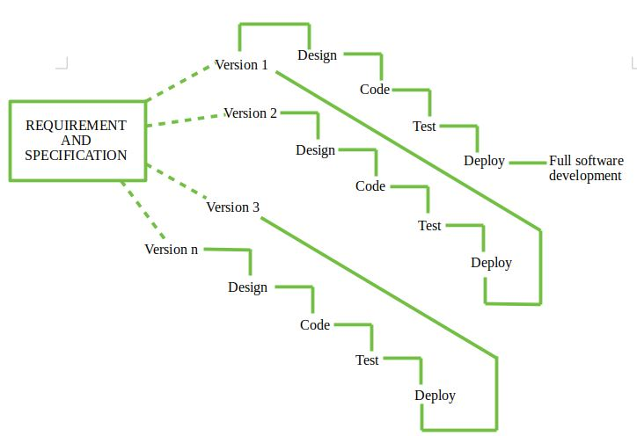
Incremental Model

Slide 6
A case study of incremental model
Suppose we want to develop a web-based social network with the following functionalities;
The user should signup for the system.
The user should log into the system and can send or accept the friend request.
How can use the incremental model in this scenario;
Solution:
We need to convert this system into separate components;
Component 1: Sign up and log in
Component 2: Send Friend request
Component 3: Accept friend request

Slide 7
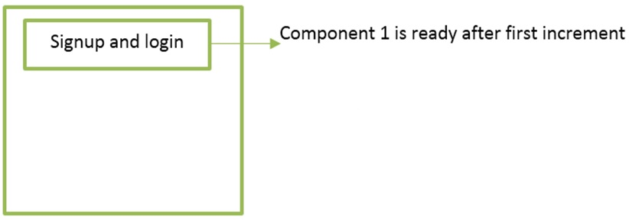
A case study of incremental model
Now, when we start our activities, then we can start with component 1(signup and login). This component undergoes the phases of requirements gathering and analysis, design, implementation, deployment, and maintenance. When this component is ready, we deliver this one component to the customer.

Slide 8
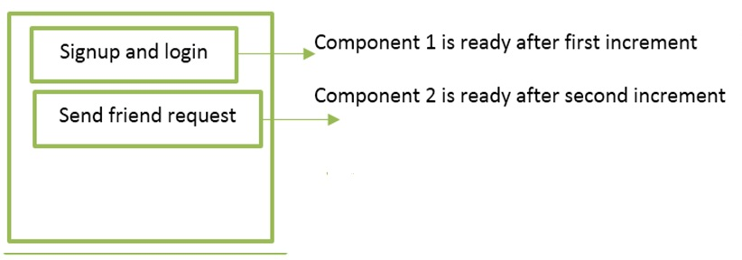
A case study of incremental model
After that, we add or increment another component 2 that sends the friend request. This component undergoes the phases of requirements gathering and analysis, design, implementation, deployment, and maintenance. When this component is ready, we deliver this one component to the customer.

Slide 9
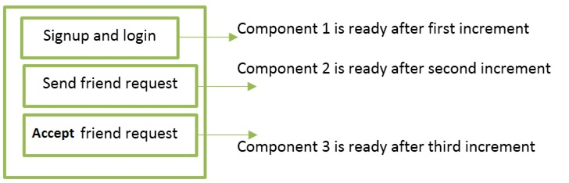
A case study of incremental model
After that, we add or increment another component 3 that accepts a friend request. This component undergoes the phases of requirements gathering and analysis, design, implementation, deployment, and maintenance. When this component is ready, we deliver this one component to the customer.

Slide 10
Incremental Model
Types of Incremental model –
Staged Delivery Model –
Construction of only one part of the project at a time.
Parallel Development Model –
Different subsystems are developed at the same time. It can decrease the calendar time needed for the development, i.e. TTM (Time to Market), if enough Resources are available.
https://www.geeksforgeeks.org/software-engineering-incremental-process-model/

Slide 11
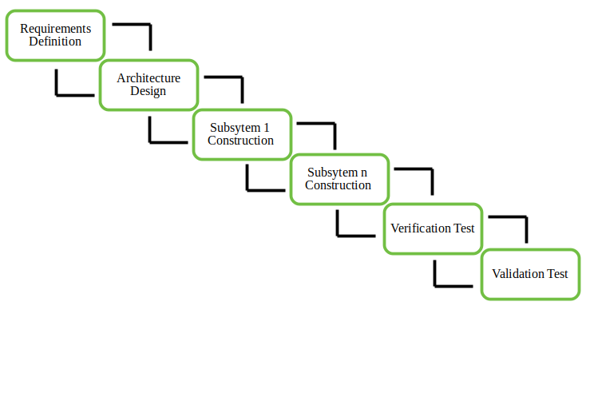
Incremental Model
Staged Delivery Model –
https://www.geeksforgeeks.org/software-engineering-incremental-process-model/

Slide 12
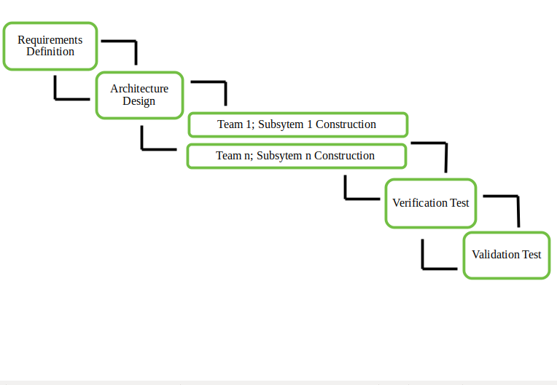
Incremental Model
Parallel Development Model –
https://www.geeksforgeeks.org/software-engineering-incremental-process-model/

Slide 13
Incremental Model
When we use the Incremental Model?
Funding Schedule, Risk, Program Complexity, or need for early realization of benefits.
When Requirements are known up-front.
When Projects having lengthy developments schedules.
Projects with new Technology.
Advantage
Errors are easy to be recognized.
Easier to test and debug
More flexible.
Simple to manage risk because it handled during its iteration.
The Client gets important functionality early.
Disadvantage
Need for good planning
Total Cost is high.
Well defined module interfaces are needed.

Slide 14
V-Model
The left side of the model is Software Development Life Cycle - SDLC
The right side of the model is Software Test Life Cycle - STLC
The entire figure looks like a V, hence the name V – model
V-Model referred to as the Verification and Validation Model.
Process executes in a sequential manner in V-shape.
It is based on the association of a testing phase for each corresponding development stage. Development of each step directly associated with the testing phase.
The next phase starts only after completion of the previous phase.

Slide 15
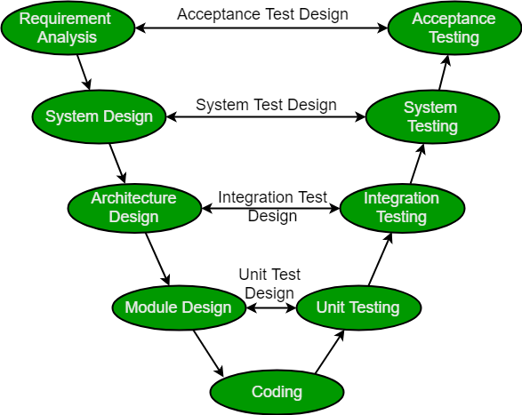
V-Model
https://www.geeksforgeeks.org/software-engineering-sdlc-v-model/

Slide 16
V-Model
Design Phase:
Requirement Analysis
System Design
Architectural Design
Module Design
Testing Phases
Unit Testing
Integration testing
System Testing
User Acceptance Testing (UAT)

Slide 17
V-Model
Design Phase:
Requirement Analysis: This phase contains detailed communication with the customer to understand their requirements and expectations. This stage is known as Requirement Gathering.
System Design: This phase contains the system design and the complete hardware and communication setup for developing product.
Architectural Design: System design is broken down further into modules taking up different functionalities. The data transfer and communication between the internal modules and with the outside world (other systems) is clearly understood.
Module Design: In this phase the system breaks down into small modules. The detailed design of modules is specified, also known as Low-Level Design (LLD).

Slide 18
V-Model
Testing Phases
Unit Testing: Unit Test Plans are developed during module design phase. These Unit Test Plans are executed to eliminate bugs at code or unit level.
Integration testing: After completion of unit testing Integration testing is performed. In integration testing, the modules are integrated and the system is tested. Integration testing is performed on the Architecture design phase. This test verifies the communication of modules among themselves.
System Testing: System testing test the complete application with its functionality, inter dependency, and communication. It tests the functional and non-functional requirements of the developed application.
User Acceptance Testing (UAT): UAT is performed in a user environment that resembles the production environment. UAT verifies that the delivered system meets user’s requirement and system is ready for use in real world.

Slide 19
V-Model
When to use?
Where requirements are clearly defined and fixed.
The V-Model is used when ample technical resources are available with technical expertise.
Proactive defect tracking – that is defects are found at early stage.
The usage of V-Model can fall under the projects which not focus on changing the requirements, for example:
Military projects
Mission Critical projects, for example, in a Space shuttle
Embedded systems.
Projects with defined and clear requirements

Slide 20
V-Model
Advantages:
V-Model is used for small projects where project requirements are clear.
Simple and easy to understand and use.
Probability of building an error-free and good quality product.
Disadvantages:
It is not a good for complex and object-oriented projects.
It is not suitable for projects where requirements are not clear and contains high risk of changing.
It does not easily handle concurrent events.

Slide 21
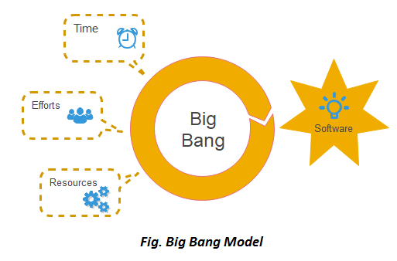
Big Bang Model
When to use Big Bang Model?
This model is required when this project is small like an academic project or a practical project. This method is also used when the size of the developer team is small and when requirements are not defined, and the release date is not confirmed or given by the customer.
Advantages:
There is no planning required.
Simple Model.
Few resources required.
Easy to manage.
Flexible for developers.

Slide 22
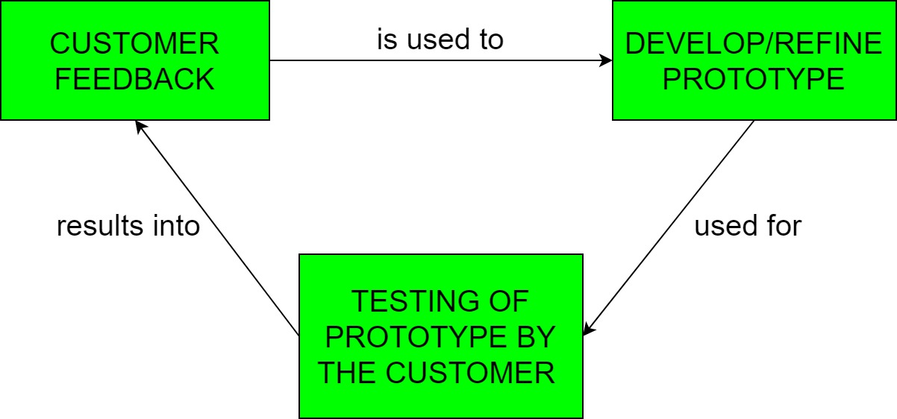
Prototyping Model
In Software Engineering, Prototype methodology is a software development model in which a prototype is built, test and then reworked when needed until an acceptable prototype is achieved.
Regular meetings are essential to keep the project on time and avoid costly delays in prototyping approach.
Missing functionality can be identified
Prototyping may encourage excessive change requests.

Slide 23
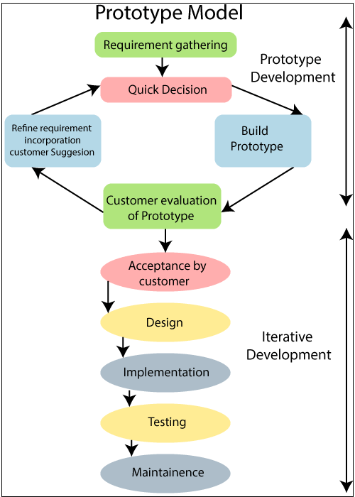
Prototyping Model
Remark:- In this model client satisfaction is guaranteed
Basic requirement identification
Developing the initial prototype
Review of the prototype
Revise and enhance the prototype

Slide 24
Prototyping Model
When to use
The Prototyping Model should be used when the requirements of the product are not clearly understood or are unstable. It can also be used if requirements are changing quickly. This model can be successfully used for developing user interfaces, high technology software-intensive systems, and systems with complex algorithms and interfaces. It is also a very good choice to demonstrate the technical feasibility of the product.

Slide 25
Prototyping Model
Advantage of Prototype Model
Reduce the risk of incorrect user requirement
Good where requirement are changing/uncommitted
Regular visible process aids management
Support early product marketing
Reduce Maintenance cost.
Errors can be detected much earlier as the system is made side by side.
Disadvantage of Prototype Model
An unstable/badly implemented prototype often becomes the final product.
Require extensive customer collaboration
Difficult to know how long the project will last.
Easy to fall back into the code and fix without proper requirement analysis, design, customer evaluation, and feedback.
Prototyping tools are expensive.
Special tools & techniques are required to build a prototype.
It is a time-consuming process.

Slide 26
Quiz 20 marks
Class-Test-01: Lecture 01 to 03
Section B 03-Feb-2021 (Class time)
Section A 04-Feb-2021 (Class time)
--------------------------------------------------
Class-Test-02: TBA
Section B 10-Feb-2021
Section A 11-Feb-2021

Slide 27

Thanks to All

